Slide 1


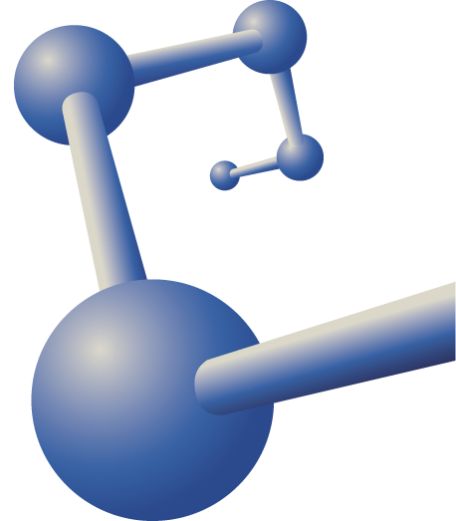
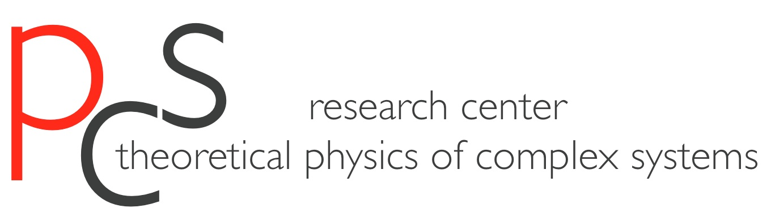

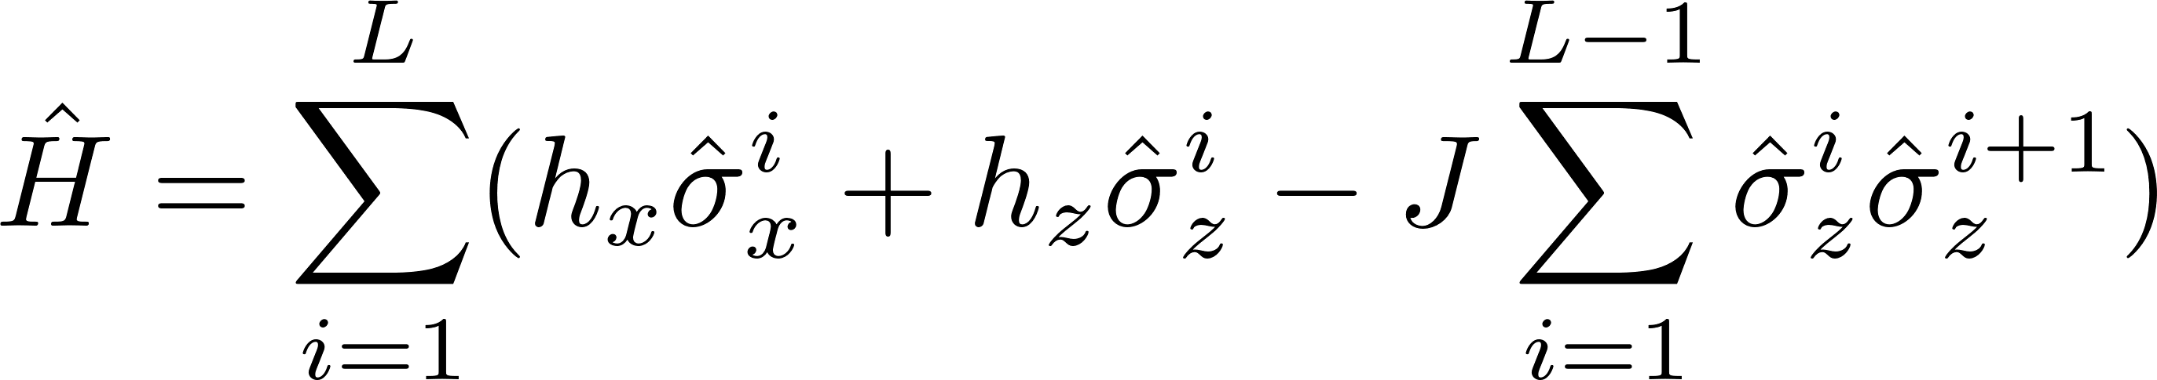
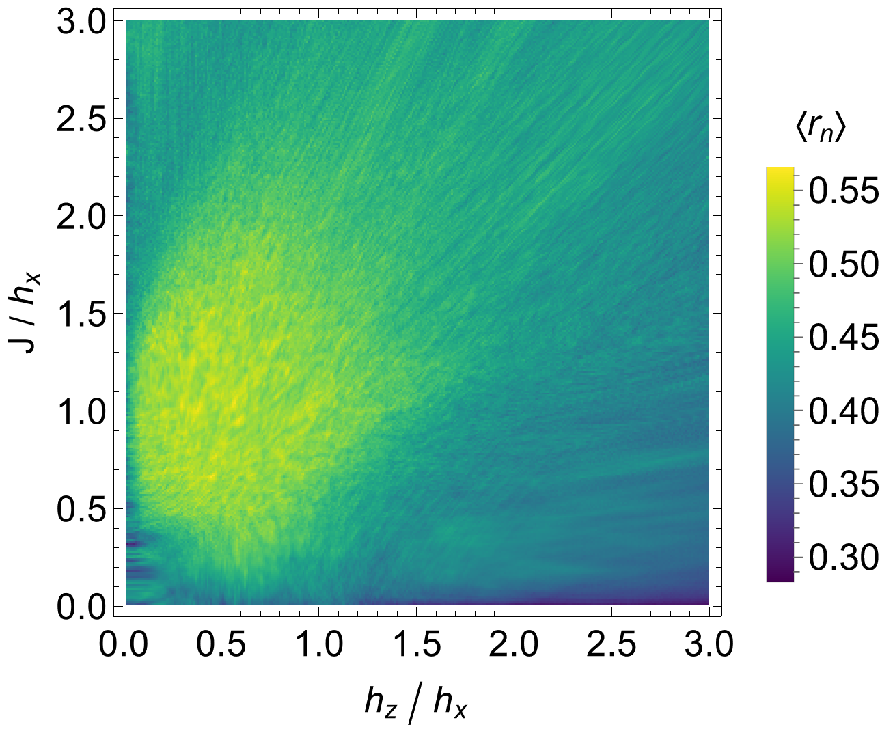
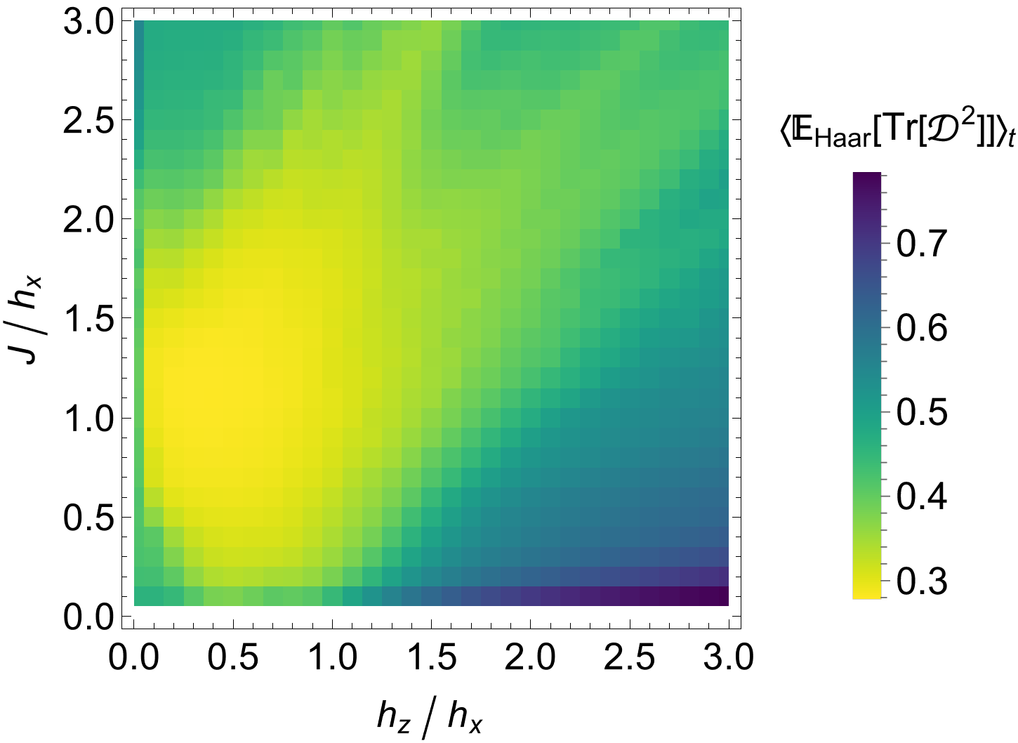
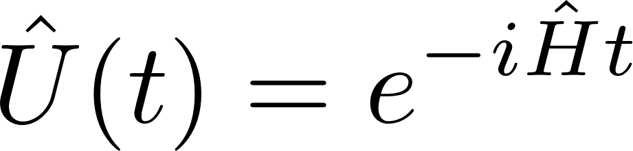
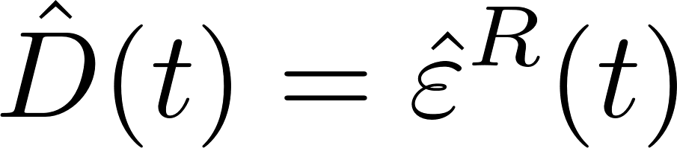

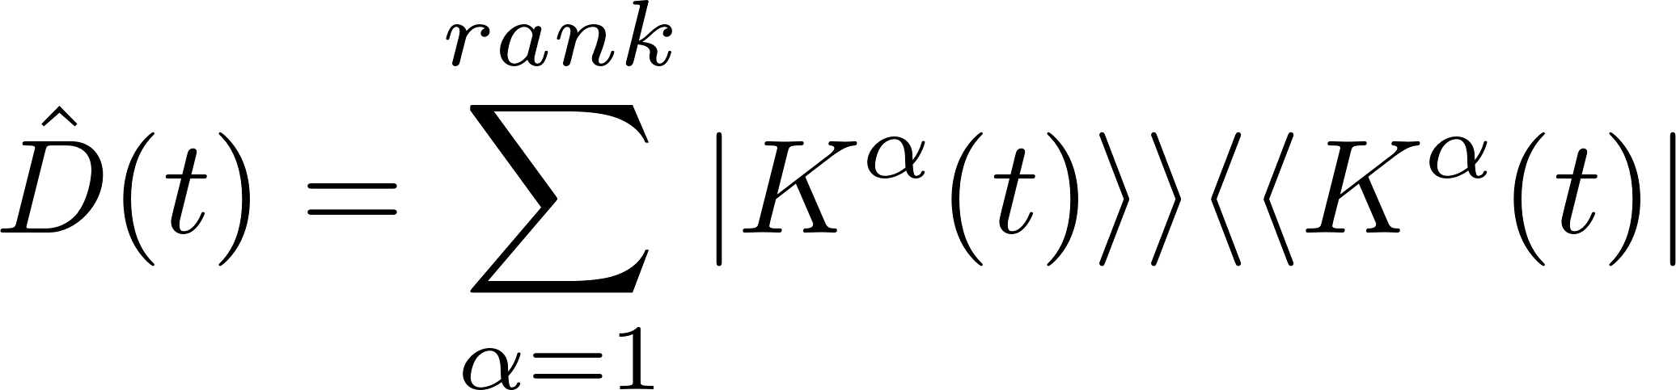
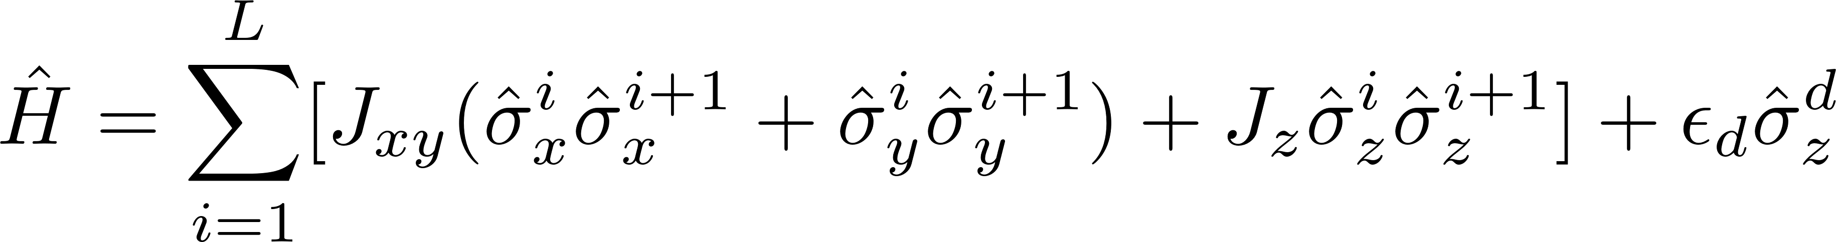

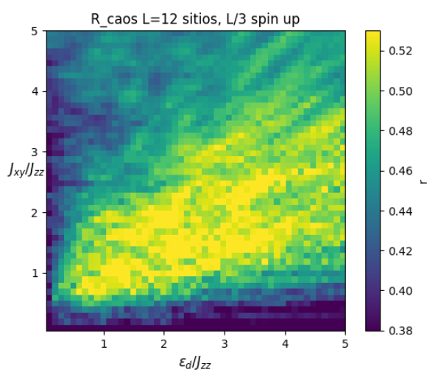
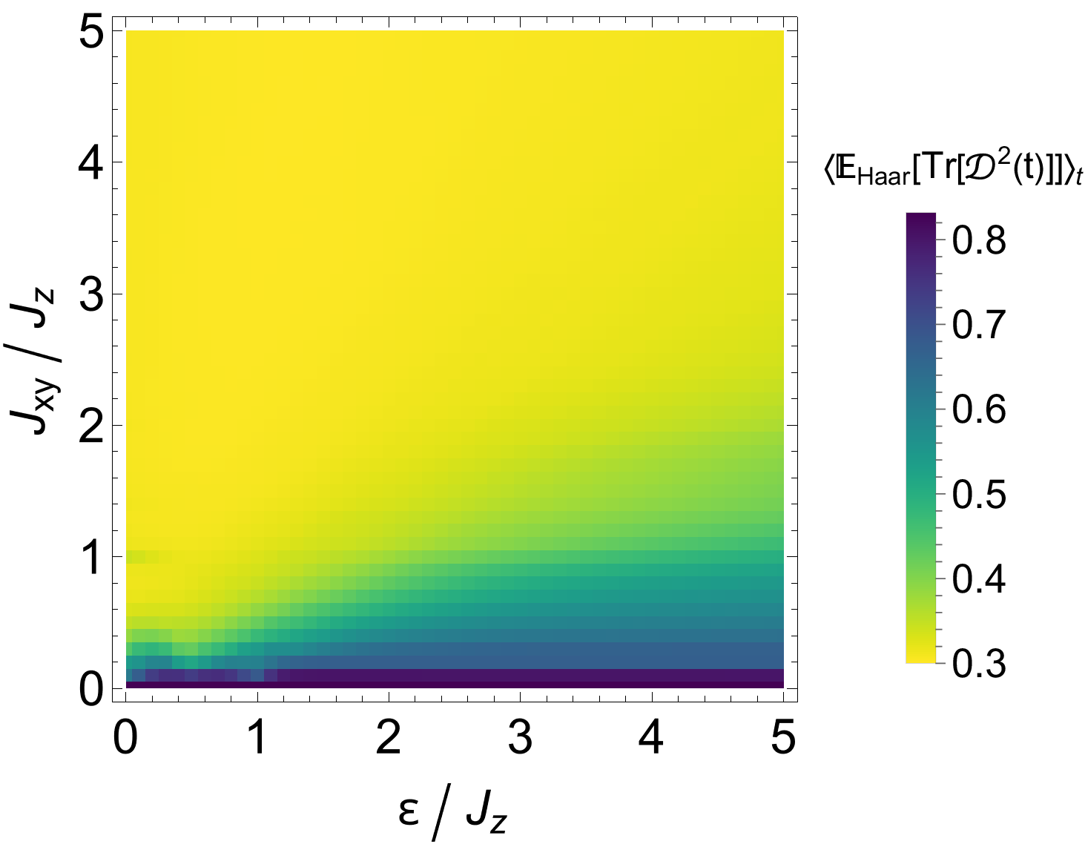
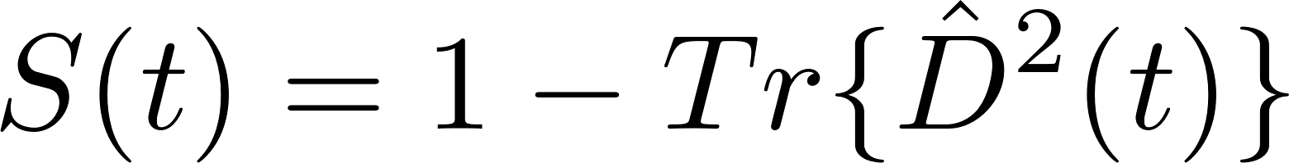
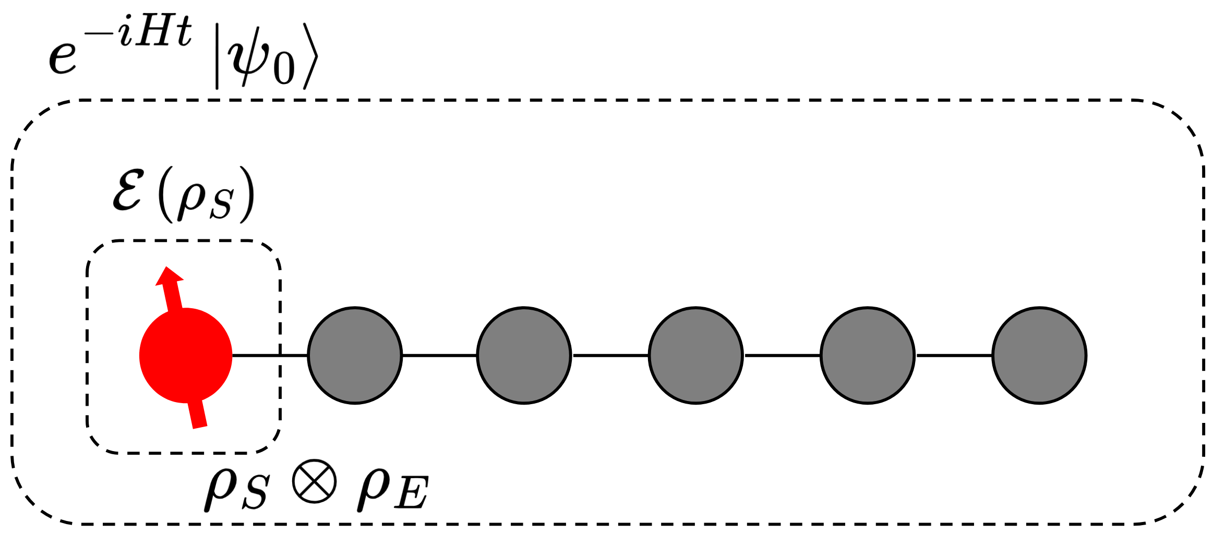
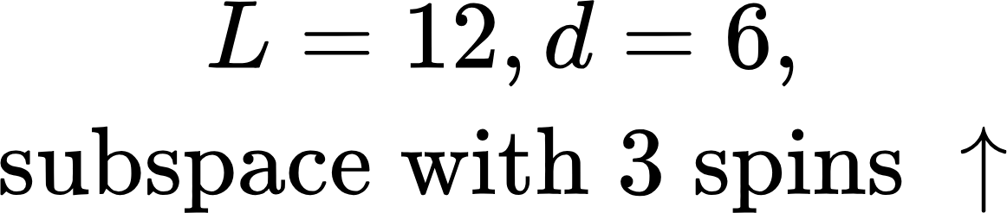
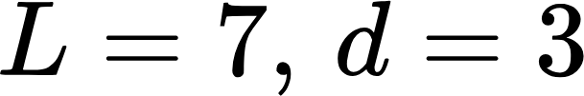

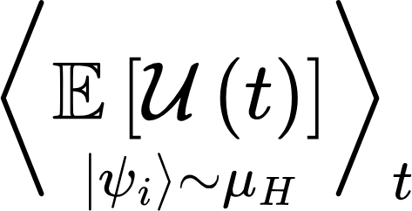
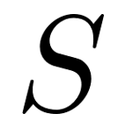
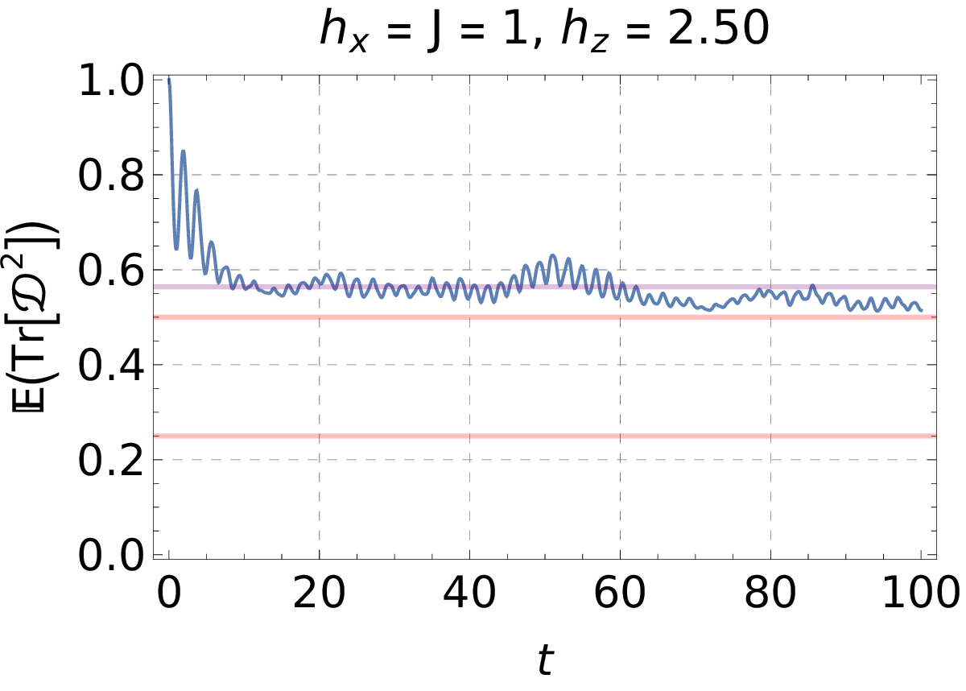
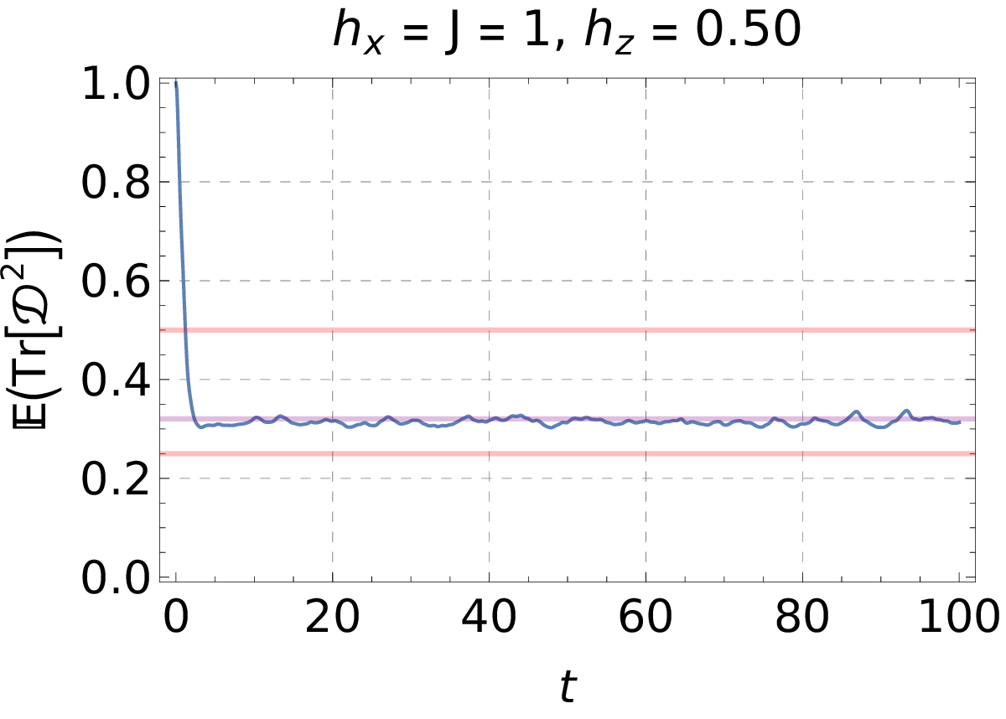
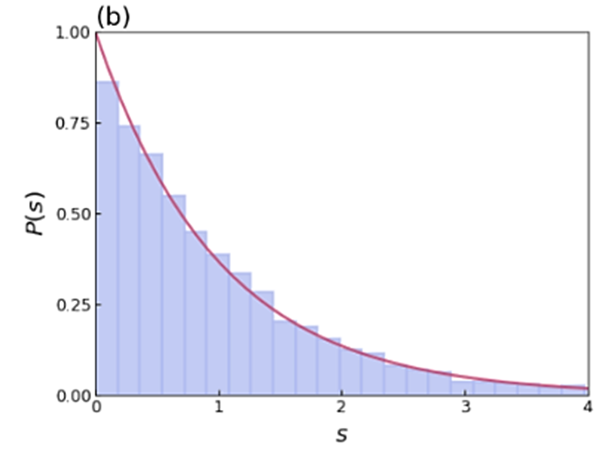
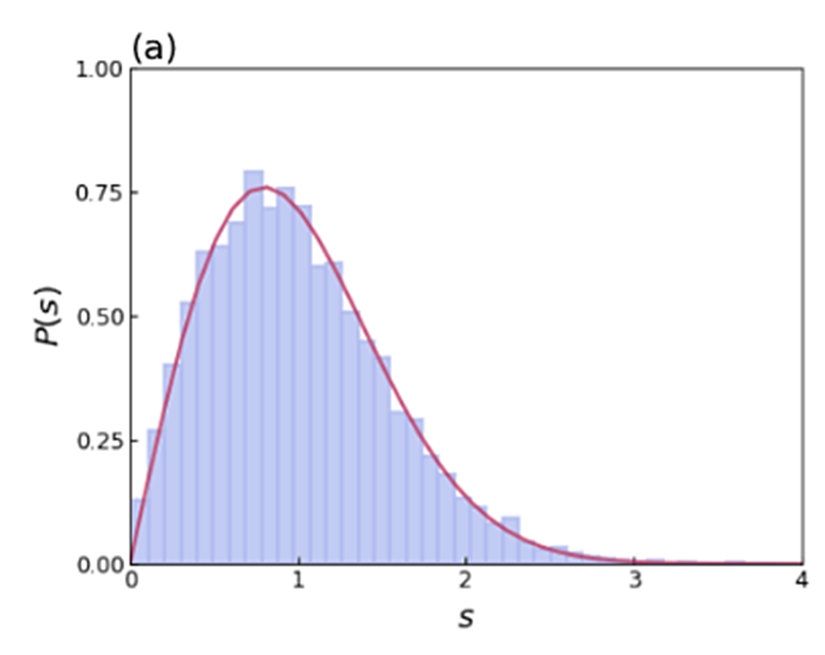
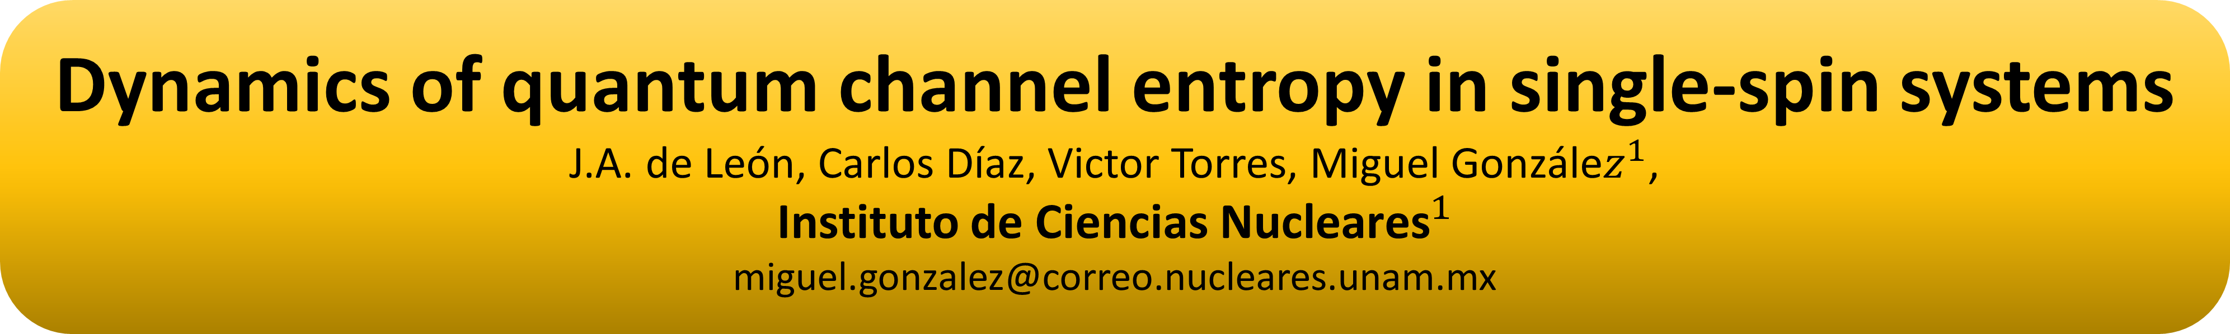
Dynamics of quantum channel entropy in single-spin systems
J.A. de León, Carlos Díaz, Victor Torres, Miguel Gonzále$z^{1}$,
Instituto de Ciencias ${\text{Nucleares}}^{1}$
miguel.gonzalez@correo.nucleares.unam.mx
Quantum channel formalism
Results
One of the most general approach to studying open quantum systems involves analyzing the possible linear transformation on a density matrix. Among all conceivable linear transformations, only those induced by quantum channels – completely positive trace preserving CPTP maps – are considered physically valid. A key question is whether a quantum channel can effectively characterize quantum chaos in a spin chain.
By making a time average of the entropy of the channel, we can identify the result as a quantum chaos indicator of short-range correlations of the spectrum like the mean level spacing ratio
Ising Hamiltonian
(1)
(6)
The goal is to determine whether the Hamiltonian in equation (2) exhibits regular or chaotic behavior by analyzing the properties of the quantum channel that governs the evolution of a single spin within a larger spin chain, obtained by tracing out the remaining spins.
(2)
Entropy of a quantum channel
Using the Choi-Jamilkosky formalism, one can analyze the properties of a quantum channel in terms of Choi density matrix. Thus, the linear entropy of a quantum is defined in terms of the purity of the Choi matrix
(3)
We are interested in the description of a single spin density matrix, the Kraus decomposition of the Choi operator can be written as the following
Heisenberg with defect
(4)
(7)
The rank of the Choi operator is directly related to the number of Kraus operator needed to perform the quantum channel evolution which will be related to the quantum chaotic characteristics of the environment. Finally, the entropy of a quantum channel is
(5)
Testing quantum chaos
The setup is as follows: we consider the reduced dynamics of the first spin of a spin chain as a probe for the entire system. Our goal is to understand how the quantum chaotic properties of the system + environment influence the entropy of the corresponding quantum channel
Conclusion & outlook
By exploring several types of spin Hamiltonians, the next figures show the typical time dependence of the entropy of the quantum channel when the respective full Hamiltonian is regular or chaotic (after averaging over all product states of the environment)
We have shown that the time-average entropy of a quantum channels effectively works as a short-range correlation detector as other quantum chaos indicators. However, unlike other traditional measures, it does not require symmetry separation or large system sizes to obtain reliable statistics.
Additionally, we present a model where the entropy of a quantum channels fails to detect quantum chaos as the mean level spacing does. What are we detecting in this model?
A key question remains: Can we extract long-range correlation of the spectrum of the Hamiltonian and compare them against known measures like the survival probability or the spectral form factor?
Bibliography
[1] Nicolás Mirkin and Diego Wisniacki. Quantum chaos, equilibration, and control in extremely short spin chains. Phys. Rev. E, 103(2):L020201, February 2021
[2] Lea F. Santos, Francisco Pérez-Bernal, and E. Jonathan Torres-Herrera. Speck of chaos. Phys. Rev. Res., 2(4):043034, October 2020.
[3] Pavan Hosur, Xiao-Liang Qi, Daniel A. Roberts, and Beni Yoshida. Chaos in quantum channels. J. High En erg. Phys., 2016(2):4, February 2016
[4] Laszlo Gyongyosi Sandor Imre1 . Properties of the quantum channel. arXiv:1208.1270

